Slide 1
Computer Graphics
2022041069 이인수

Slide 2
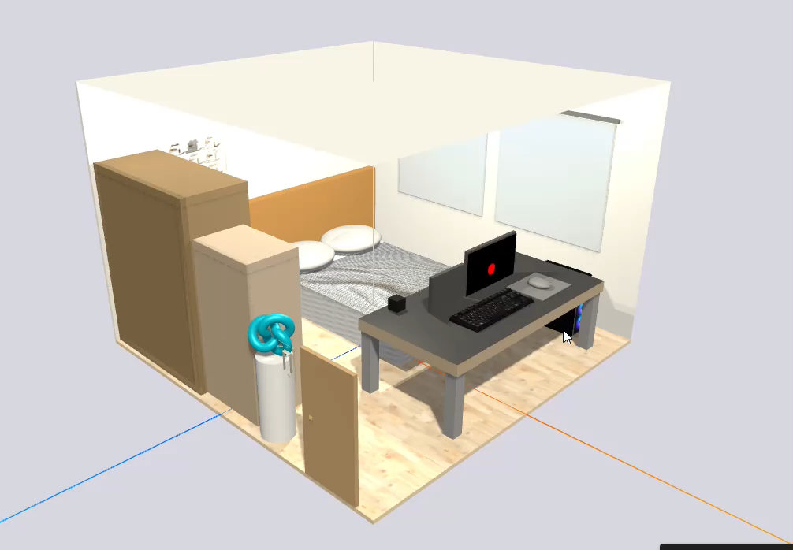
Video Sample

Slide 3
Project overview
This project is a Three.js-based real-time 3D rendering assignment that implements a room scene.
It includes external GLB models, image textures, lighting, animations, and user interactions, combining various objects and structures into a single scene.

Slide 4
2. Development Environment and Tools
2-1. Development Environment
- Windows 11
- Visual Studio Code
- Live Server extension
- Chrome browser
2-2. Libraries and Tools Used
- Three.js
- GLTFLoader
- TrackballControls
- DragControls
- Stats.js
- Markmap.js
- Blender-created or provided GLB model files

Slide 5
3. Main Components
3-1. Scene
A Three.js Scene was created and its background color was set.
All objects belong to this Scene.
3-2. Camera
A PerspectiveCamera was used, and TrackballControls were applied to allow free rotation, movement, and zoom.
3-3. Renderer
WebGLRenderer was used with shadow support, sRGB encoding, and anti-aliasing enabled.

Slide 6
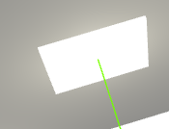
3. Main Components
3-4. Lighting
The following light sources were implemented in this project:
- AmbientLight
- DirectionalLight
- PointLight (ceiling light)
- PointLights (two stand lights)
- Emissive rectangular ceiling light
3-5. Texture and Material
The following textures were loaded and applied:
- mattress_texture.png
- sheet_texture.jpg
- duvet_texture.jpg
- pillow_texture.jpg
- catImage.png

Slide 7
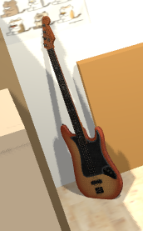
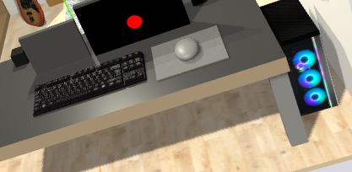
3. Main Components
3-6. GLB Model Loading
GLTFLoader was used to load the following GLB models:
- bass_guitar.glb
- keyboard.glb
- Computer.glb
- hangersAndShirts.glb
- light_switch.glb

Slide 8
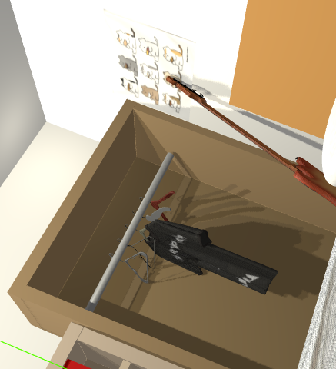
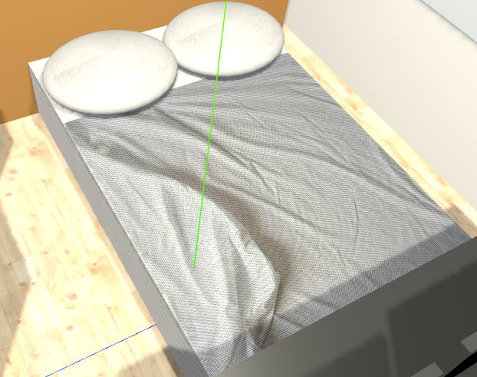
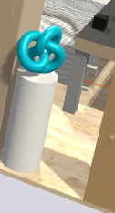
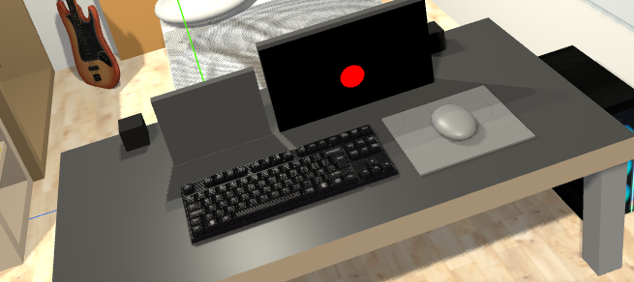
3. Main Components
3-7. Major Object Groups
1) Bedding Group
- Mattress
- Pillows
- Duvet
- Bed sheet
2) Desk Setup Group
- Desk
- Two monitors
- GLB keyboard
- Mouse pad
- Mouse (movable with DragControls)
- Desktop computer (GLB)
3) Storage Group
- Bookshelf
- Multiple books
- Wardrobe
- Hangers and shirts (GLB)
4) Other Single Objects
- Air purifier
- Torus knot decoration
- Wall picture

Slide 9
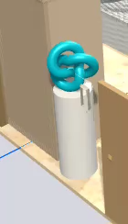
3. Main Components
3-8. Animation
AnimationMixer was used to create door opening and closing animations.
The TorusKnot object was given a looping rotation AnimationClip.
Mouse movement values were mapped into screen space to animate a 2D ball displayed on the monitor.
The light switch was implemented so that clicking it turns lights on or off.

Slide 10
3. Main Components
3-9. Interaction
User interactions were implemented as follows:
- DragControls were used to allow the mouse object to move only within the mousepad area.
- Clicking the door triggers the opening or closing animation.
- Clicking the switch toggles all lights on or off.
- Clicking the computer case toggles the appearance of a 2D ball on the monitor screen.
- When the ball is visible, clicking the mouse changes its color randomly.

Slide 11
4. Animate Loop
The animate function updates the following elements every frame:
- AnimationMixer updates
- Door animation updates
- Torus animation updates
- TrackballControls updates
- Monitor 2D ball position mapped from the mouse position
- renderer.render(scene, camera) call

Slide 12
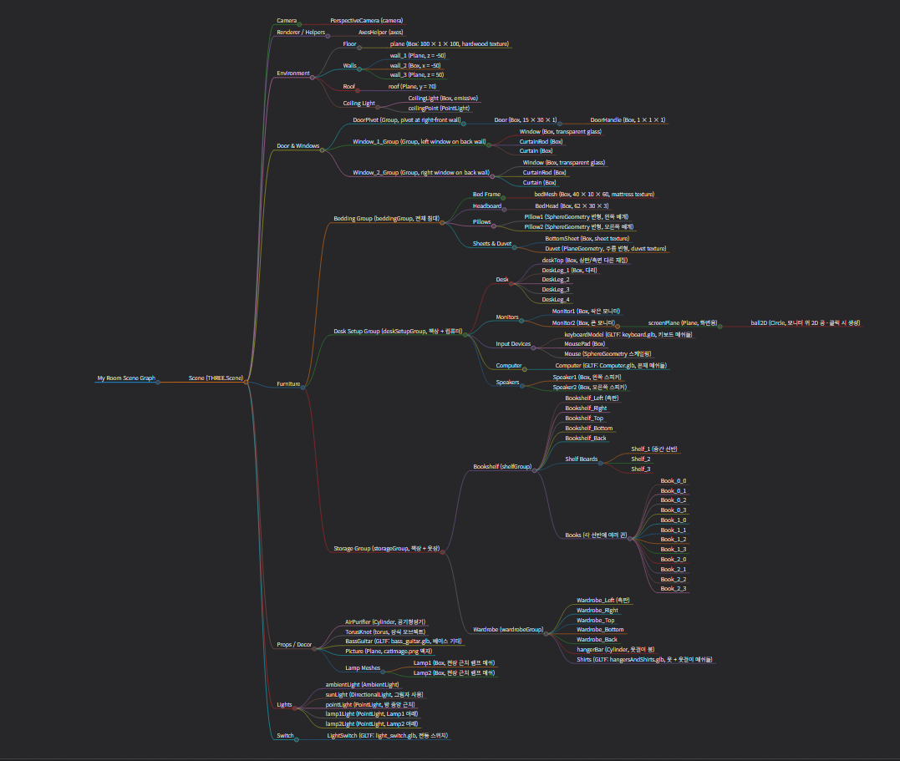
5. Scene Graph Structure
SceneGraph.html

